Slide 1
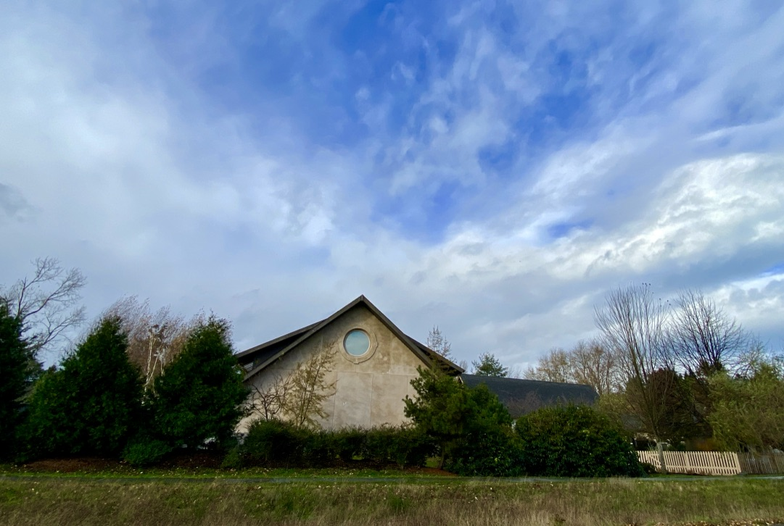
Shared Policy Governance Overview
March 2023

Slide 2
CONGREGATION
MINISTRY
VISIONARY
PROGRAM COUNCIL
5 Council Leads, Program Council Chair and the Minister
5 COUNCILS
Ministry Team Chairs within each Council
Spirit
Community
Social & Environmental Justice
Growth & Learning
Operations
BOARD
(Elected by
Congregation)
Executive
Team
Coordinating Team (Ministerial Advisory Team)
(On Hiatus 2022-2023)
MINISTRY TEAMS
All QUUF members who create, plan & implement our programs
BOARD COMMITTEES
& TASK FORCES
Congregational Committees (elected by Congregation) : Nominating, Endowments, Ministerial Search
3/23

Slide 3
The Essence of Shared Governance
A Board, elected by the Congregation, articulates and is responsible for mission, vision, values, strategic goals & fiduciary health of the Fellowship
Ministry leaders, lay leaders & staff who create effective programs that embody our mission, vision, values, & strategic goals
Members who can participate in many opportunities to learn, grow and serve
3/23

Slide 4
A Visionary Board
Board focuses on:
Developing and articulating our Mission & Values
Maintaining the Fiduciary Health of the Fellowship
Policy Development & Oversight
Working with the Congregation to identify the Fellowship’s one, three and five year Strategic Goals
3/23

Slide 5
Board Committees & Task Forces
STANDING COMMITTEES
Denominational Affairs
Long Range Planning
Widening the Circle
Healthy Community Team
Personnel
Fundraising Coordinating
SHORT TERM COMMITTEES & TASK FORCES
Governance
Bylaws Review
Ministerial Hiring
3/23

Slide 6
Ministry
Minister is responsible for implementing programs and operations designed to meet the Fellowship’s strategic goals, mission & values
Guides lay leaders, volunteers and staff to support and enhance our programmatic life
Is responsible for daily decisions and activities (what to do and how)
Works, as a member of the Program Council, to resolve conflicts between Ministry Teams or Councils
3/23

Slide 7
Ministry Teams
Ministry Teams are
made up of QUUF members who create, plan & implement the Fellowship’s Programs.
MINISTRY TEAMS IN THE COMMUNITY COUNCIL:
Affinity Groups, Covenant Groups, Friendship Suppers, Newcomer Outreach, Pastoral Care, Retreats (Men’s & Women’s), Volunteer Engagement Team
MINISTRY TEAMS IN THE SOCIAL & ENVIRONMENTAL JUSTICE COUNCIL:
Affordable Housing Action, Antiracism/8th Principle, Christmas Giving, Designated Offering, Green Sanctuary Environmental Action, Jefferson County Immigration Advocates, Native Connections Action, Pet Helpers, Animal Advocates, Welcoming Congregation
MINISTRY TEAMS IN THE SPIRIT COUNCIL:
Aesthetics, Meditation Groups, Music Programs, Production, Sunday Services
MINISTRY TEAMS IN THE OPERATIONS COUNCIL:
Administration/IT, Accessibility, Facilities, Safety & Risk Management, Fundraisers (auction, book sale, rummage sale, etc.) Kitchen Care, Memorial Circle & Columbarium, Pledge Campaign,
MINISTRY TEAMS WITHIN THE GROWTH & LEARNING COUNCIL:
Agnostics, Humanists, Atheists, Adult Learning Programs, Library, Religious Education Children & Youth
3/23

Slide 8
Councils
5 Councils:
Community
Social & Environmental Justice
Spirit
Operations
Growth & Learning
Each Council is made up of the Chairs of the Ministry Teams within that Council
Council Leads are members with experience related to that council who are chosen by members of that Council and approved by the Board
Responsibilities of Councils:
Ensure Ministry Teams’ programs and charters support and enhance our Mission, Values & Strategic Goals
Promote internal & external Council communication, cooperation and support
Work to resolve challenges & conflicts within their Ministry teams and with inter-Council Ministry Teams
Celebrate successes
3/23

Slide 9
Program Council
The governing body for QUUF’s Programs, which is made up of the Ministry Teams & Councils
Members are the 5 Council Leads, the Program Council Chair & the Minister
Ensures all Ministry Teams’ & Councils’ charters & programs adhere to the mission, values, bylaws, policies & procedures of the Fellowship
Confirms that all Ministry Teams are supporting and advancing the Fellowship’s strategic objectives, as defined by the Board
Responsible for resolving conflicts between Ministry Teams from different Councils
Communicates and coordinates throughout the program structure and with the Board, through the Minister
In the future will plan and facilitate Shared Ministry Assemblies
3/23

Slide 10
Executive Team
Optimizes Board logistics, including meeting agendas
Handles emergent issues that must be dealt with at the Board level
Executive Team Members: Board President, Board Vice President, Minister, members of the staff
3/23

Slide 11
CONGREGATION
MINISTRY
VISIONARY
PROGRAM COUNCIL
5 Council Leads, Program Council Chair and the Minister
5 COUNCILS
Ministry Team Chairs within each Council
Spirit
Community
Social & Environmental Justice
Growth & Learning
Operations
BOARD
(Elected by
Congregation)
Executive
Team
Coordinating Team (Ministerial Advisory Team)
(On Hiatus 2022-2023)
MINISTRY TEAMS
All QUUF members who create, plan & implement our programs
BOARD COMMITTEES
& TASK FORCES
Congregational Committees (elected by Congregation) : Nominating, Endowments, Ministerial Search
3/23

